Slide 1
Simulation of Transactive Energy Six Use Cases
By Yuxin Wu

Slide 2
What is transactive energy?
Definition from Wikipedia:
Transactive energy refers to the economic and control techniques used to manage the flow or exchange of energy within an existing electric power systems in regards to economic and based standard values of energy.

Slide 3
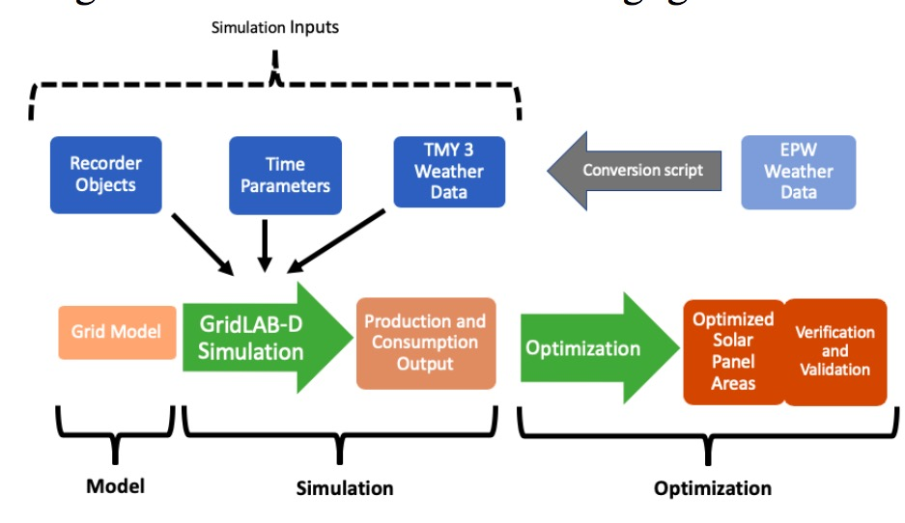
Image Source: Modeling and Optimization of a Longitudinally-Distributed Global Solar Grid
The Workflow of Our Simulation Experiment

Slide 4
TE Six Use Cases
• UC1: Peak Heat Day and Energy Supply;
• UC2: Wind Energy Balancing Reserves;
• UC3: High-Penetration PV and Voltage Control;
• UC4: EVs on the Neighborhood Transformer;
• UC5: Islanded Microgrid Energy Balancing;
• UC6: System Constraint Resulting in Mandatory Curtailment.

Slide 5

UC1:Peak Heat Day and Energy Supply;
Summary: The grid is severely strained in capacity and requires additional load shedding/shifting or storage resources. Narrative: The weather has been hot for an extended period, and it has now reached an afternoon extreme temperature peak. Electricity, bulk-generation resources have all been tapped and first-tier DER(Distributed Energy Resource) resources have already been called. The grid operator still has back-up DER resources, including curtailing large customers on interruptible contracts. The goal is to use TE designs to incentivize more DER to participate in lowering the demand on the grid.

Slide 6
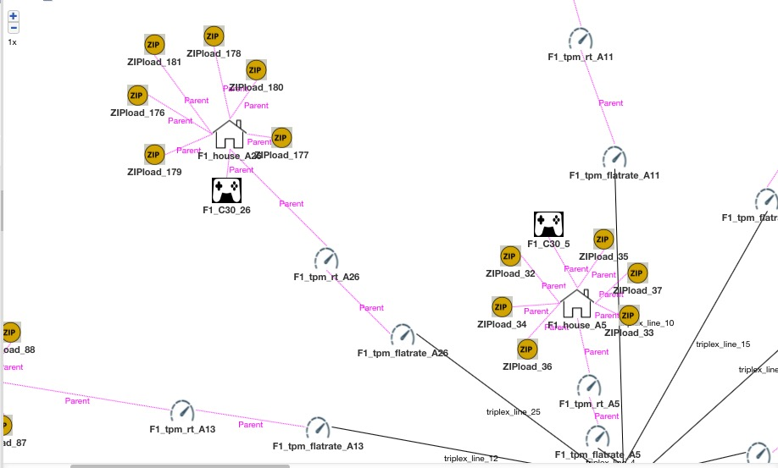
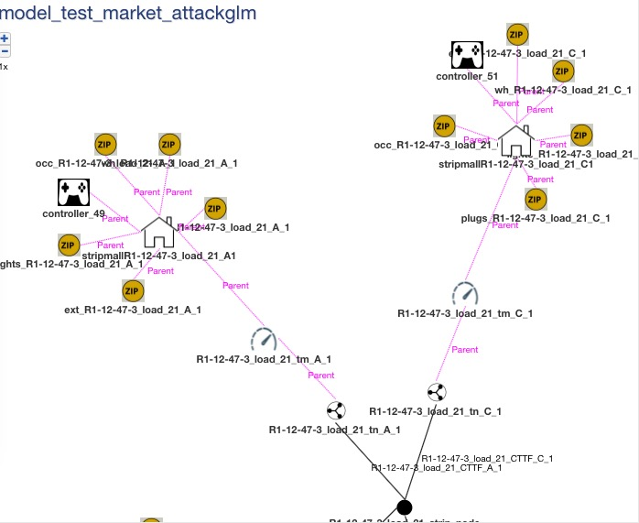
Approach and Steps to simulate UC1
Step 1. Modeling
I plan to use TE30 feeder or adjust the market-attack-test model to fit specifically for this scenario. And Import the grid model in GridLab-D.
Fig.1. Part of the TE30 example model
Fig.2. Part of the market-attack-test model

Slide 7
Step 2: Simulation
(1)Choose the base-case scenario: the system anticipates the event that morning or even earlier before the predicted time of the peak load.
(2) Input dependency files which include weather data, time parameters, and recorder objects, etc.
(3) Run the base case simulation and gain the outcome.csv result.
(4) In the test scenario (when the time of peak load comes), we need to raise the price in double-auction transactive market which coordinates battery energy storage and residential space conditioning and electric water heaters to reduce demand.
(5) Run the simulation in Gridlab-D again, gain the new outcome.csv file.

Slide 8
Step 3: Data Optimization and Validation
Step 4: Compare two outcome.csv files and gain the conclusion

Slide 9
Thanks for listening!

